Slide 1

jam
Jobs At Your Doorsteps

Slide 2
introduction
Jobs at Mail is an online job portal.
The portal acts as an intermediate between Jobseekers and Employers.
The purpose is to enable the Jobseekers to search for the jobs from any remote location.
This is a web-based application, which provides common platform for Jobseekers and Employers.
Employers can post jobs according to their requirements and jobseekers can search and apply for jobs after login.
Jobseekers can view the jobs as per their skill set and experience.

Slide 3
ENTITIES INVOLVED
In this web application there are three major entities that are involved: -
Jobseeker
Recruiter
Administrator

Slide 4
JOBSEEKER
This entity provides functionalities for job seekers. Applicants can post their resumes with personal and professional details.
They can also update the resume as frequently as required. The applicant can also browse through the present vacancies available.
Upload resume
View jobs
Search jobs
Apply for jobs
Re-Build Resume

Slide 5
RECRUITER
This entity provides functionalities related to employers.
Employers can post vacancy details and update the details as and when necessary.
Employers can search through applicant resumes based on different criteria.
Post jobs
Resume Search
Featured jobs facility

Slide 6
ADMINISTRATOR
Administrator manages entire application and maintains the profiles of applicants and employers.
View Resume
Update the job detail.
Reply to feedback
Reply to queries
Add the job detail.
Delete or manage the old job details.
Admin can manage recruiter information.
Block or approve the Recruiters.

Slide 7
MODULE IN PROJECT
Jobs at Mail project has following modules: -
Job Seeker Management
Employer Management
Enquiry Management
Login and User Management
News and Events Management
Jobs Management
Applicant Management

Slide 8
DESCRIPTION OF MODULES
Job Seeker Management : - This module contains job seeker registration with given fields. Job seeker can manage profile, login, search job and apply for job.
Employer Management : - This module contains employer registration with given fields. Employer can manage profile, login, post job and applicant management.
Enquiry Management : - Through this module any user can raise enquiry from general zone regarding any issue and the enquiry is managed by administrator.
Login and User Management : - Login Management is a very important module of any project. This module is responsible for validation and tracking users.
News and Event Management : - Through this module admin can post news and events which are displayed on notice board.
Job Management : - In this module, Employer can post jobs and receive responses.
Applicant Management : - In this module Employer can view job seeker and schedule interviews.

Slide 9
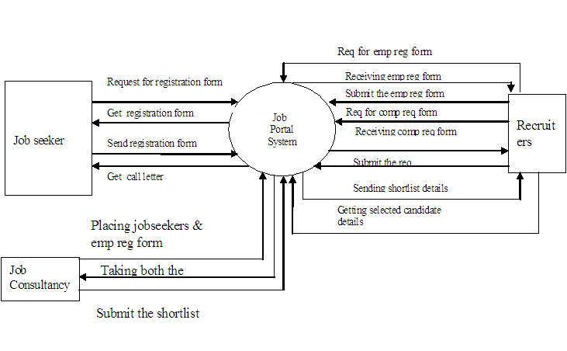
DATA FLOW DIAGRAM
JOB SEEKER
JOB PORTAL SYSTEM
RECRUITER
SUBMIT THE REQEST

Slide 10
FUTURE SCOPE OF PROJECT
The system is flexible enough to ensure well-coordinated efforts to face the strategic challenges emerging from rapidly changing economic environment and global trends.
Facilities have been incorporated in the software so that online processing can be done easily and thus the effort and time can be saved.
In future it is planned to develop our own web server to host the web application.

Slide 11
Reference
GeekforGeeks website
https://www.djangoproject.com
https://www.w3schools.com
https://youtu.be/gfDE2a7MKjA

Slide 12
Thank you

